Slide 1
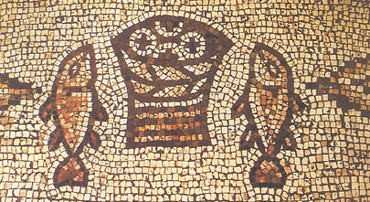
Spirit Journeys Australia
forging Authentic Christian Engagement
at the heart of Australian community life
through Desert Spirit Journeys and Makes You Wonder

Slide 2
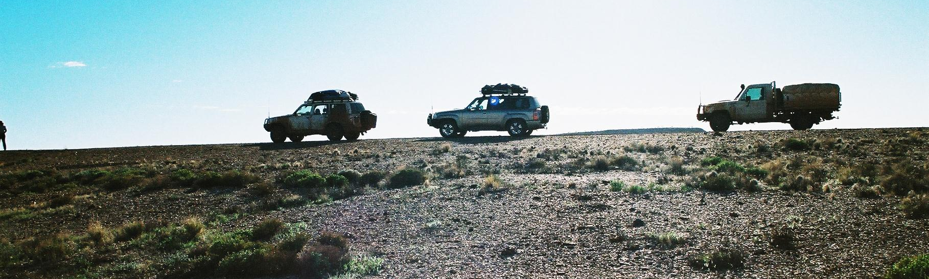
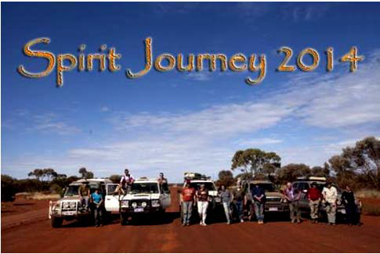
Desert Spirit Journeys
To find depth for the journey
We lead Spirit Journeys into the Australian wilderness
We lead Pilgrimage to the Holy Lands
We publish Resources

Slide 3
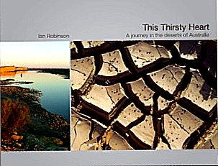
Publications

Slide 4
QUOTES from This Thirsty Heart
Our civilisation generates mountains of waste in land and sea and sky. How can we live better with less?
All religions speak of the inward beauty from a fierce landscape. Australia’s desert is a resource for a needy world.
For all of us, our journey through life crosses many ‘deserts’, the harsh terrain of the soul. I have good news for you.

Slide 5
Latest publication
If Anyone Thirsts are the words of Jesus, shouted out across a crowd of pilgrims at the most inappropriate moment. It will lead you down the lost seam of gold that is desert spirituality in the bible. Our exploration will show that a physical connection with the desert has been both definitive and necessary for the faith of the bible.
Foreword by Prof David Tacey

Slide 6
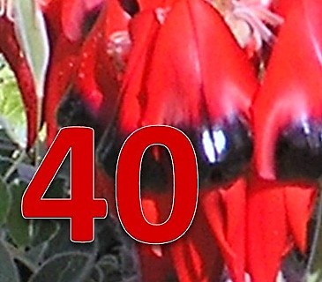
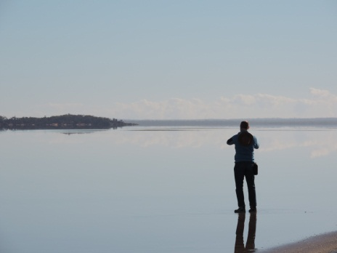
Audio
Article
IN DEVELOPMENT:
a 40 Day Virtual Desert Journey
For smartphone and website
Three connections daily – morn noon night
2 min/5 min/15 minute levels of audio and visual and meditation
‘Learning for change’ theory
Weekly review

Slide 7
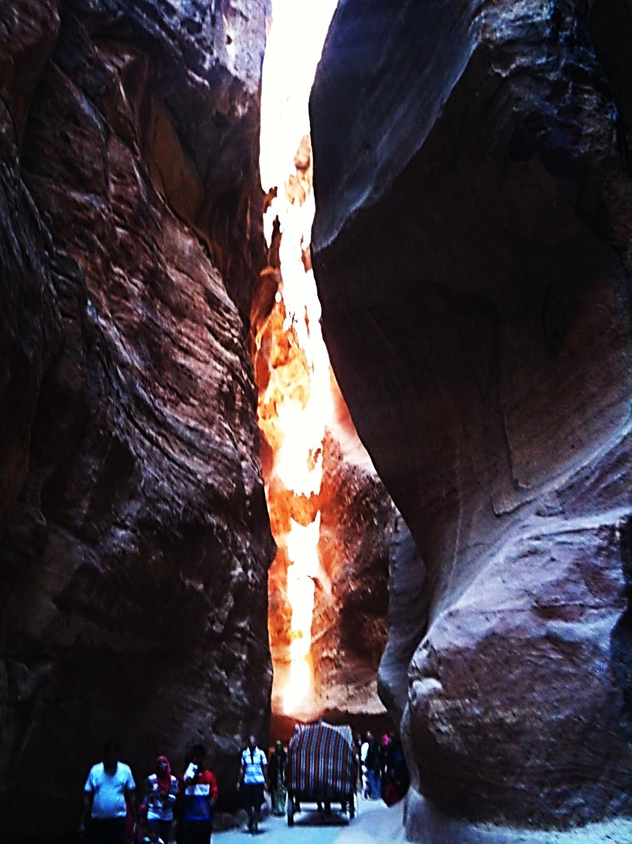
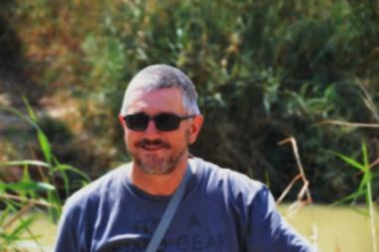
>Twenty YA
>To Israel Palestine and Jordan
>Nov 28-Dec 14 2015 $6500
>Ten older mentors 12/12
>Preceded by 6 bible webinars
> Leader: Ian Robinson
>Partnered with UC First Third, UC Multicultural and Palestinian church including Christian Pilgrimage Inc
Young Adult Pilgrimage

Slide 8

Makes You Wonder
  To sustain biblical gospel outreach
We help people to find their own voice with their own faith in their own world
We resource an increase in capacity, culture and confidence
THROUGH
MYW Leaders Training
Small Group Resources
WXED presentations
Publications

Slide 9
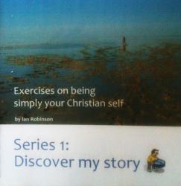
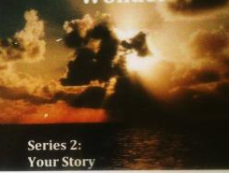
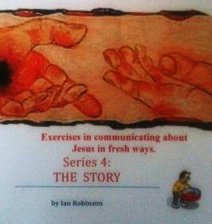
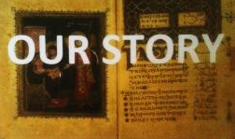
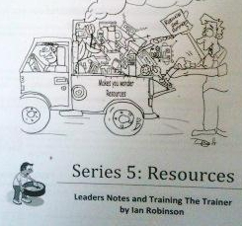
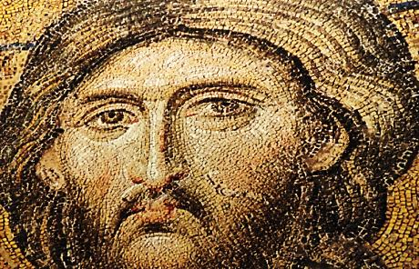

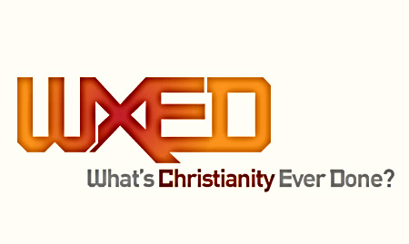
Makes You Wonder Resources
My Story
Your Story
Our Story
The Story
MYW Leaders Training
Wonder Workshops
Burning Hope
Purple Cow Workshops

Slide 10
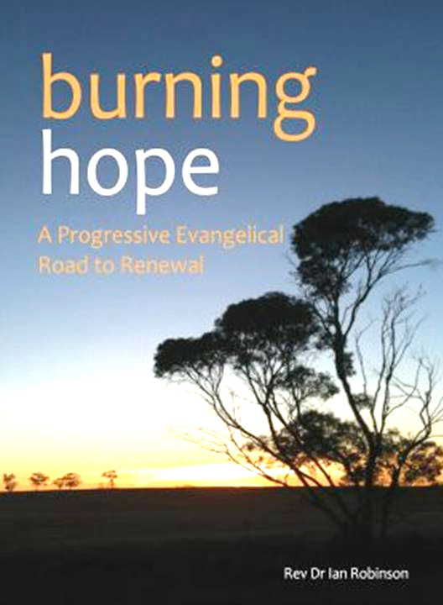
New Book
Burning Hope
A Progressive Evangelical Road to Renewal
Published by Mediacom Adelaide
GOSPEL, CONTEXT, LEADERSHIP: 22 essays with charts and discussion questions
But if I say, "I will not mention him or speak any more in his name," his word is in my heart like a fire, a fire shut up in my bones. I am weary of holding it in; indeed, I cannot. Jeremiah 20.9 NIV

Slide 11
QUOTES from Burning Hope
Most evangelism today is a rusted old car. It reflects an old glory but can’t function well now.
Many of the churches’ internal struggles and our own individual struggles are mirrored by those around us. Let’s not pretend that we are doing better than we are. We then connect.
Ask people: “how are you really?” They will be shocked that someone actually wants to know the answer to the question. Just asking is a gift.

Slide 12
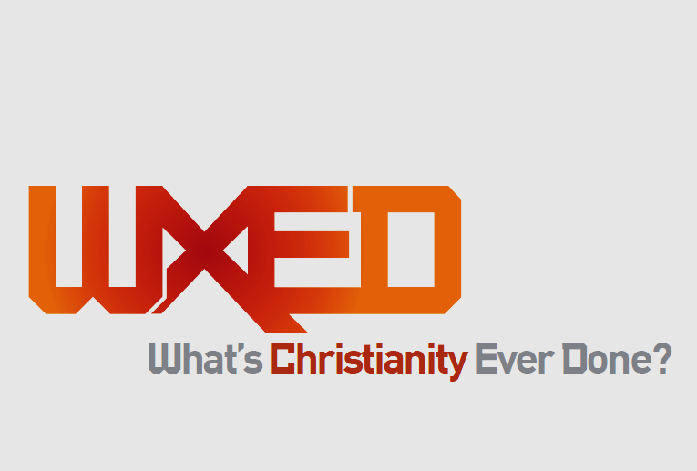
Cultural Impact
WXED Law
WXED Arts
WXED Education
WXED Healthcare
WXED Science
2015 series
Nedlands Uniting
Trinity @ Uni of WA
City Churches

Slide 13
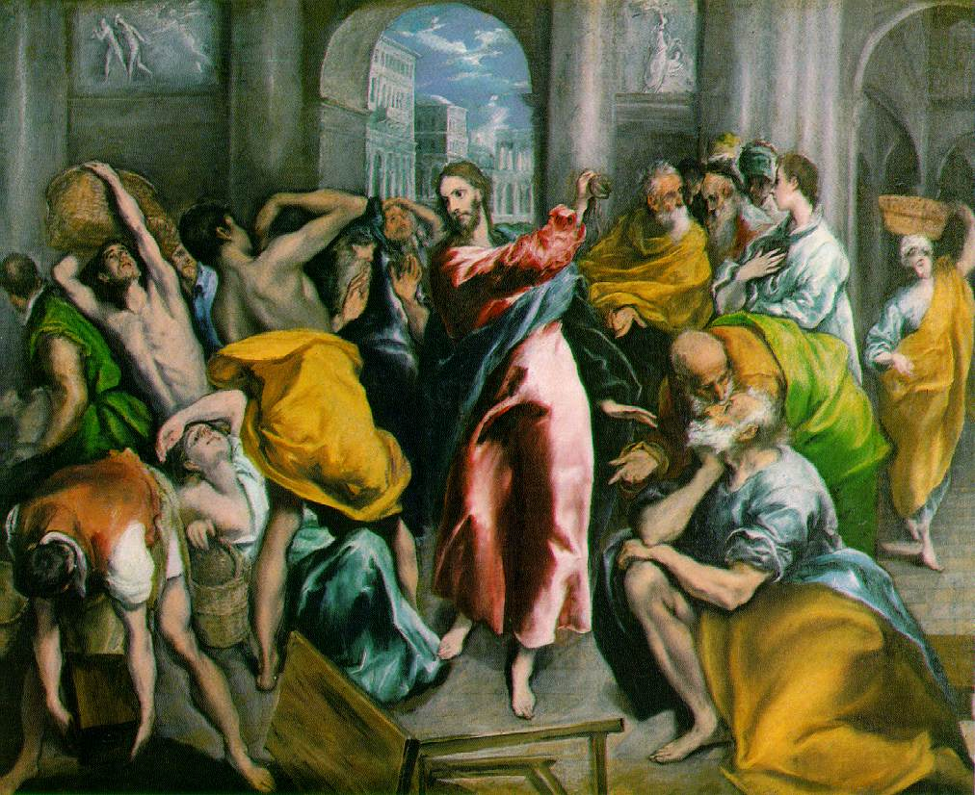
Good and Angry
WHO DID JESUS CONFRONT AND WHY?
a vital small group study book
  St Augustine:
  Hope has two beautiful daughters; their names are Anger and Courage. Anger that things are the way they are. Courage to make them the way they ought to be.
In challenging times, churches are choosing different methods to recover their impact on the world. Some repeat the mistakes that made Jesus angry. Have I become a Pharisee? a Sadducee? Am I going along with the Herodians? Do I stand with today's Samaritans or not?

Slide 14
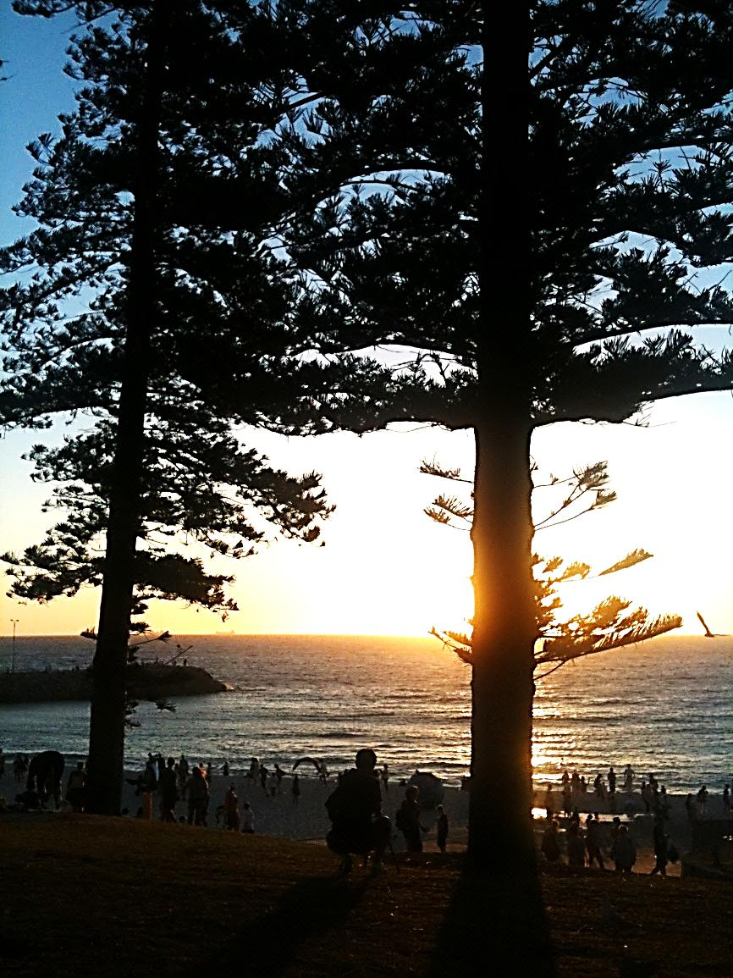
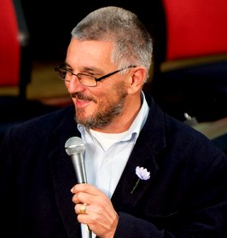
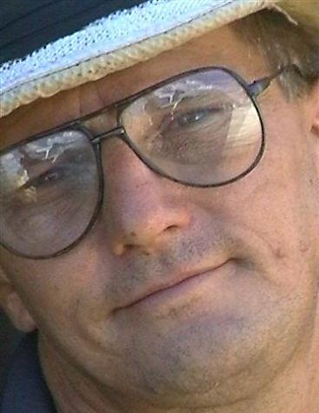
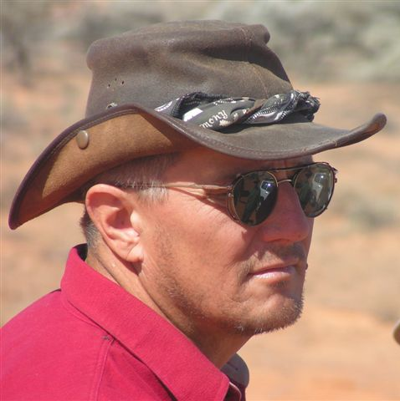
The New Back Room
Tall Trees ReSource
Online Donation and Pay facility via Pay Pal
Profile of Ian Robinson
Profile of Tall Trees Board members
Walking Reconciliation Road

Slide 15
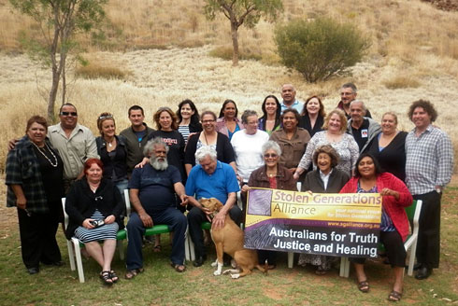
Walking…
Reconciliation Road
  To heal Australia’s ‘original sin’
  Bringing Them Home WA
  Healing, Truth and Justice for stolen generations

Slide 16
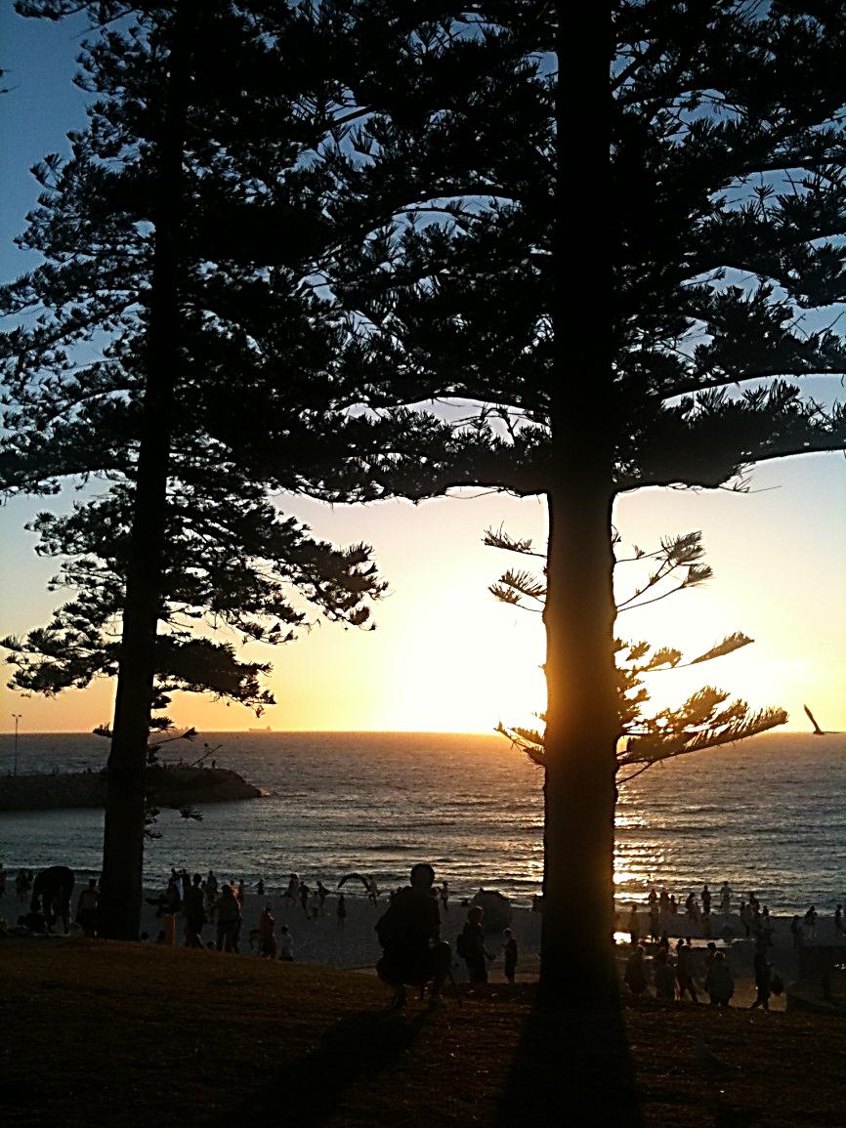
Tall Trees ReSource
Goal: Authentic Christian Engagement
at the heart of community life.

Slide 17
What Progress in Expanding Influence?
2014-15 CORE DIRECTIONS
To rebrand, simplify and improve online systems –
  Two Paths plus a new backroom with one business model
  New overall name – Australian Spirit Journeys
Generational change : trainees and mentees who may become advocates or associates
Legacy publications – get them out

